Slide 1
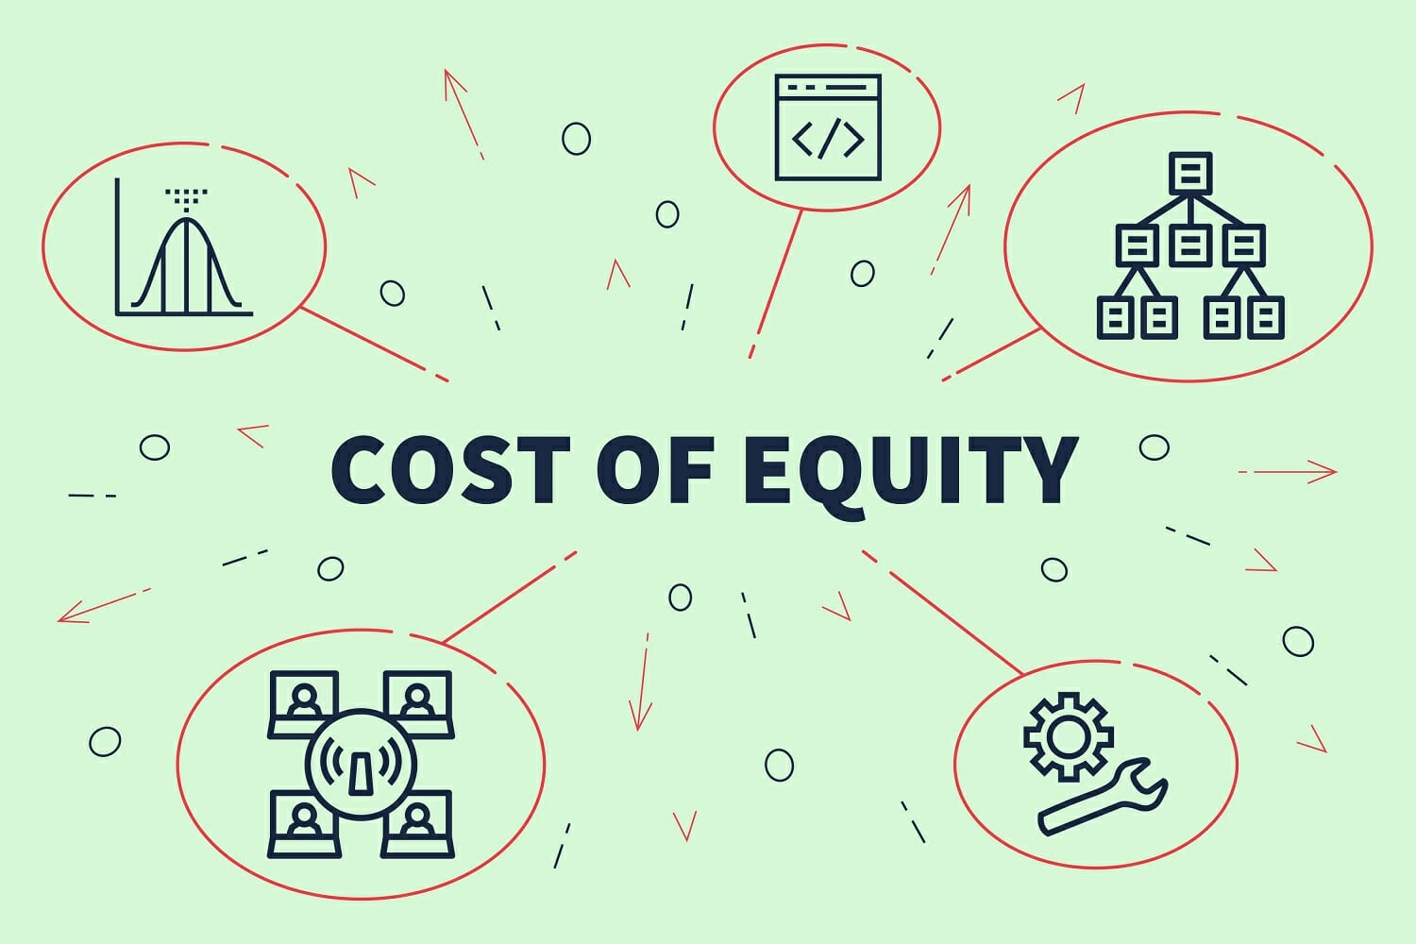

Slide 2
Cost of Equity-
Cost of equity capital represents the expectations of equity shareholders from a company. Based on investors behaviour and expectation, the cost of equity capital can be determined by any of the following approach

Slide 3
Dividend/Price Approach-The approach is based on the thinking that what the investors expect when they put in their savings in the company. It means that the investor arrives at the market price for a share by capitalizing the expected dividend at a normal rate of return. Though, this approach is simple, but it suffers from two serious weaknesses These are-
It ignores the earnings on company's retained earnings, which increases the rate of dividend in equity share.
It ignores the fact that price rise of shares may be due to the retained earnings also and not on account of only high rate of dividend.
K_{e}= $\frac{Dividend per share }{ Market price per share}$
This approach applies where companies have stable dividend policy.

Slide 4
Earning/Price Approach-The E/P ratio assumes that shareholders capitalize a stream of uncharged earnings by the capitalization rate of E/P ratio in order to evaluate their holdings. The advocates of this approach, however, differ on the earnings figure and market price.
This approach also has three main limitations-
All earnings are not distributed among the shareholders in the form of dividend.
Earnings per share cannot be assumed to be constant as this approach emphasizes,
Share price does not remain constant because investments in retained earnings result in market price of share.
K_{e}= $\frac{Earning per share }{ Market price per share}$

Slide 5
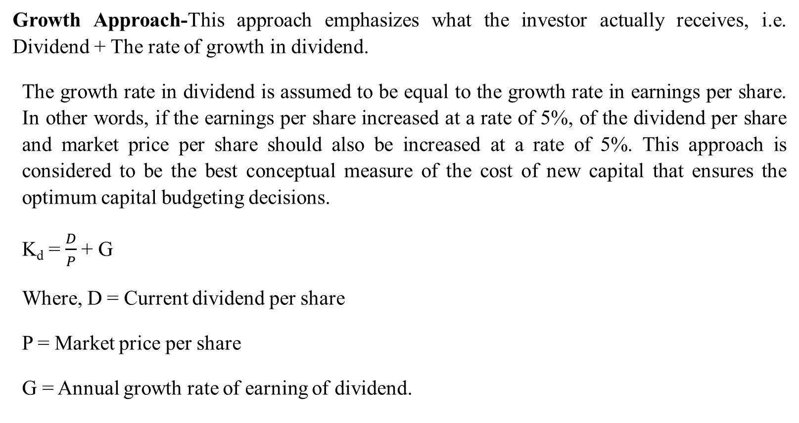
Growth Approach-This approach emphasizes what the investor actually receives, i.e. Dividend + The rate of growth in dividend.
The growth rate in dividend is assumed to be equal to the growth rate in earnings per share. In other words, if the earnings per share increased at a rate of 5%, of the dividend per share and market price per share should also be increased at a rate of 5%. This approach is considered to be the best conceptual measure of the cost of new capital that ensures the optimum capital budgeting decisions.
K_{d} = $\frac{D}{P}$+ G
Where, D = Current dividend per share
P = Market price per share
G = Annual growth rate of earning of dividend.

Slide 6

K_{e}= $\frac{E}{P }$+ G
Where, E = Current earnings per share
P = Market price per share
G=Annual growth rate of earnings

Slide 7
Realized Yield Approach- In case, where of future dividend and the sale price are uncertain, it is very difficult to estimate the rate of return on investment. In order to remove this difficulty, it is suggested the cost of capital. Under this approach, the realized yield is discounted at the present value factor and then compared with the value of investment.
Y_{t} = D_{t} + P_{t} / P_{t-1}
Where, Y_{t} = Yield for the year t
D_{t} = Dividend per share at the end of the year t
P_{t} = Price per share at the end of the year t
P_{t-1}= Price per share at the beginning

